Slide 1

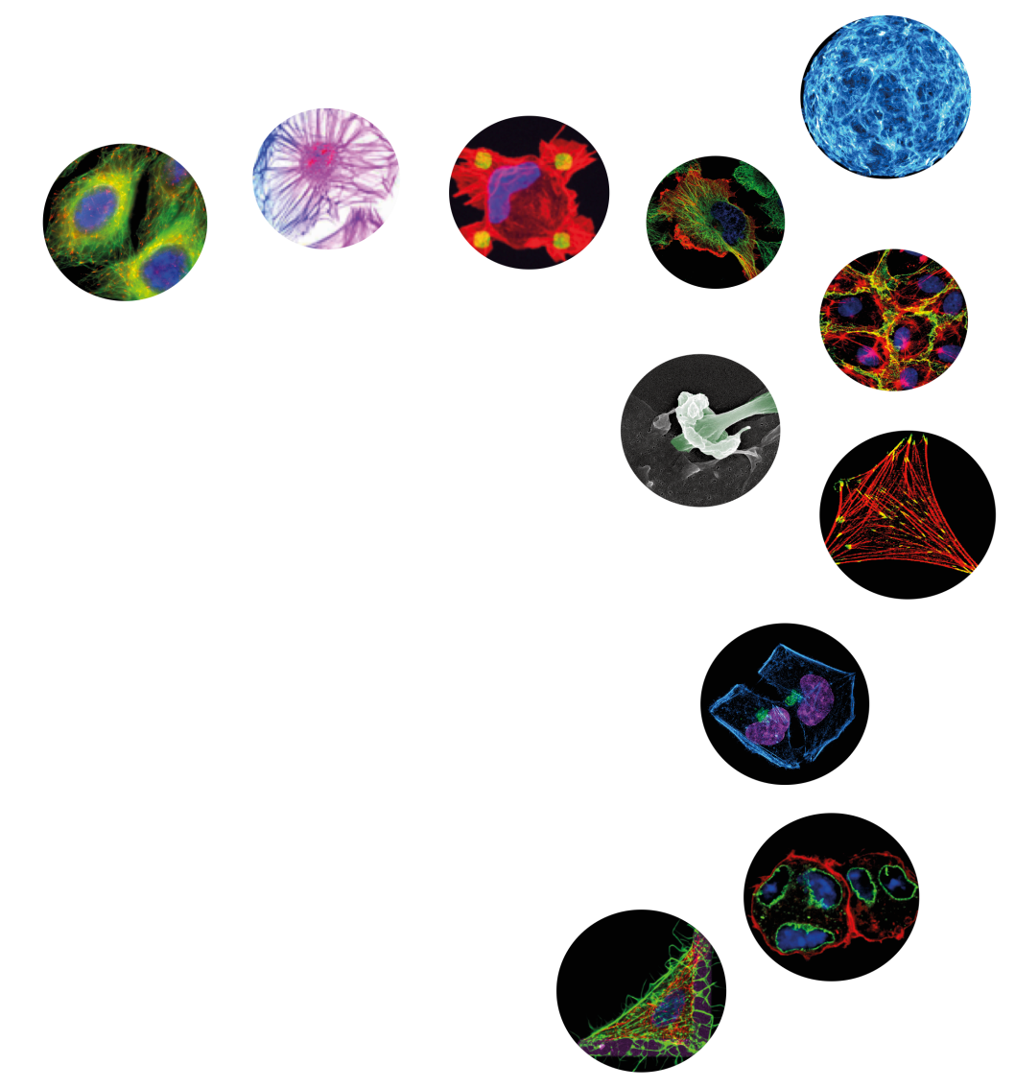
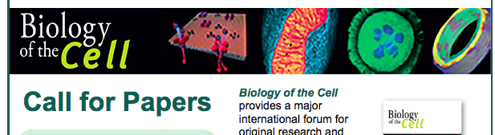
The French Society for Cell Biology
supports this meeting
> 1200 members and 180 affiliated labs
Travelships for students and post-docs
Annual Joung Researcher Prize
A monthly newsletter with
Open positions in Cell Biology labs
Upcoming Cell Biology meetings
FREE membership:
register now www.sbcf.fr
Notes:
SBCF is an inclusive, international community of biologists studying the cell, the fundamental unit of life. We are dedicated to advancing scientific discovery, advocating sound research policies, improving education, promoting professional development, and increasing diversity in the scientific workforce

