Slide 1

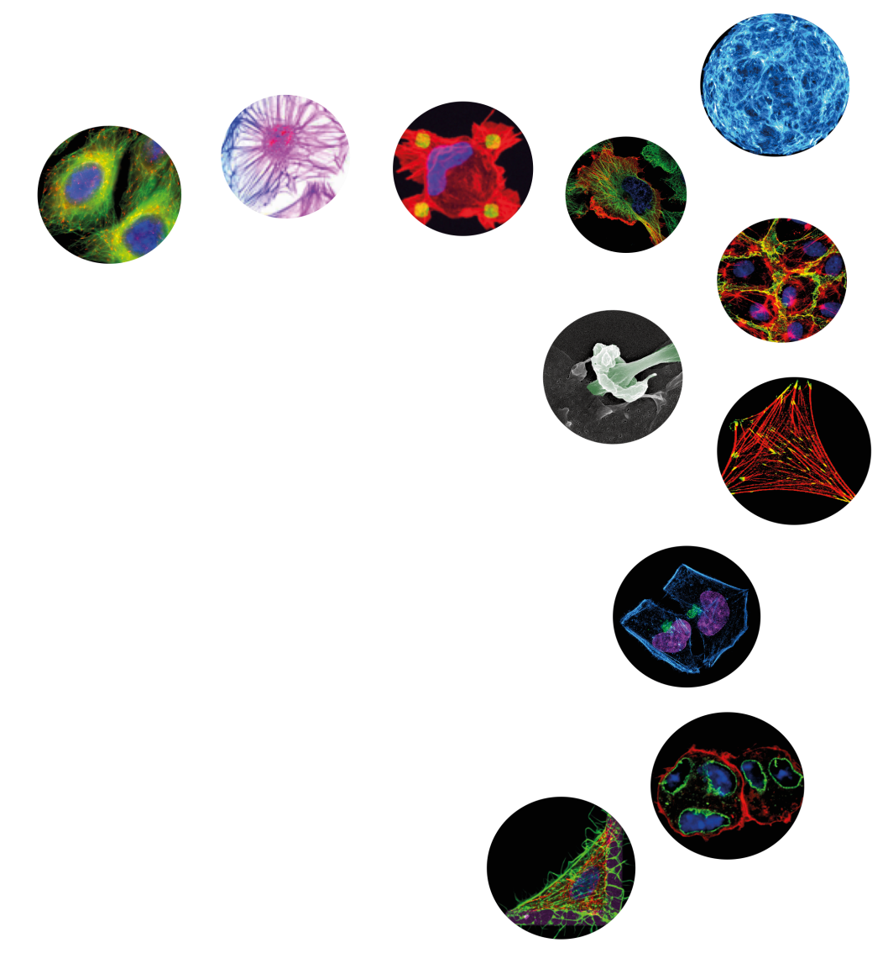
The French Society for Cell Biology
www.sbcf.fr
Notes:
SBCF is an inclusive, international community of biologists studying the cell, the fundamental unit of life. We are dedicated to advancing scientific discovery, advocating sound research policies, improving education, promoting professional development, and increasing diversity in the scientific workforce

Slide 2
The French Society for Cell Biology aims at
promoting cell biology research and education
www.sbcf.fr

Slide 3

Founded in 1983
More than 1200 members
More than 180 affiliated research teams
Mailing list of more than 2000 contacts
www.sbcf.fr

Slide 4


OUR MISSIONS
Promoting cell biology research and education
Supporting conferences in cell biology
Sponsoring travel grants
Advancing scientific discovery by stimulating partnerships
Rewarding young researchers
Promoting professional development in cell biology
Advocating sound research policies
Publishing « Biology of the Cell »

Slide 5
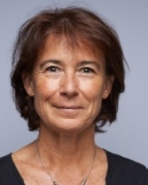
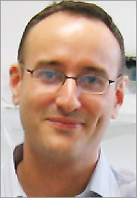

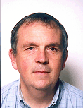
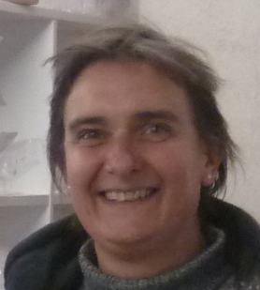
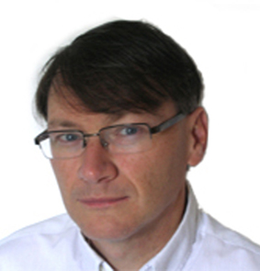
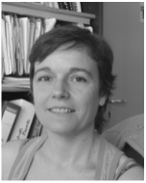
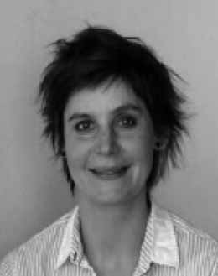
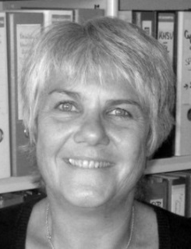
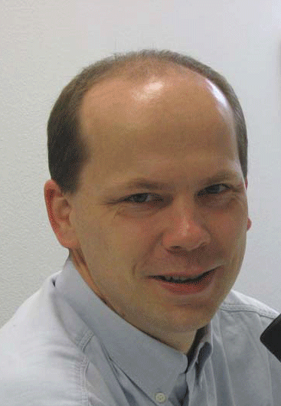
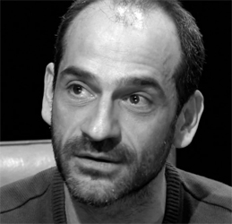
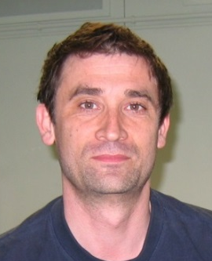
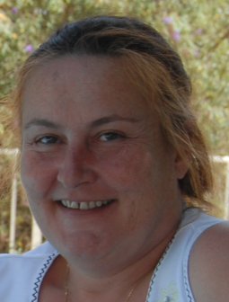
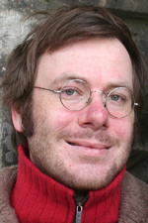
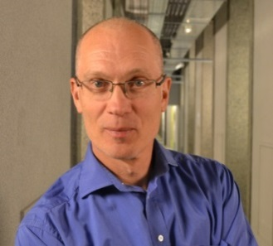
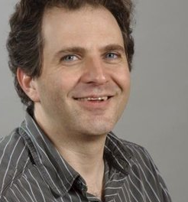
Executive board
President
Vice-President
Treasurer
Vice-Treasurer
Secretary
Vice-Secretary
C. Albiges-Rizo
A. Echard
H. Barelli
RM. Mège
A. Blangy
F. Lafont
Advisory board
V. Moreau
S. Miserey
-Lenkei
B. Sola
G. Michaux
F. Perez
F. André
V. Baldin
Education
Communication
Editor
Biology of the cell
J. Enninga
I. Kramer
T. Galli

Slide 6


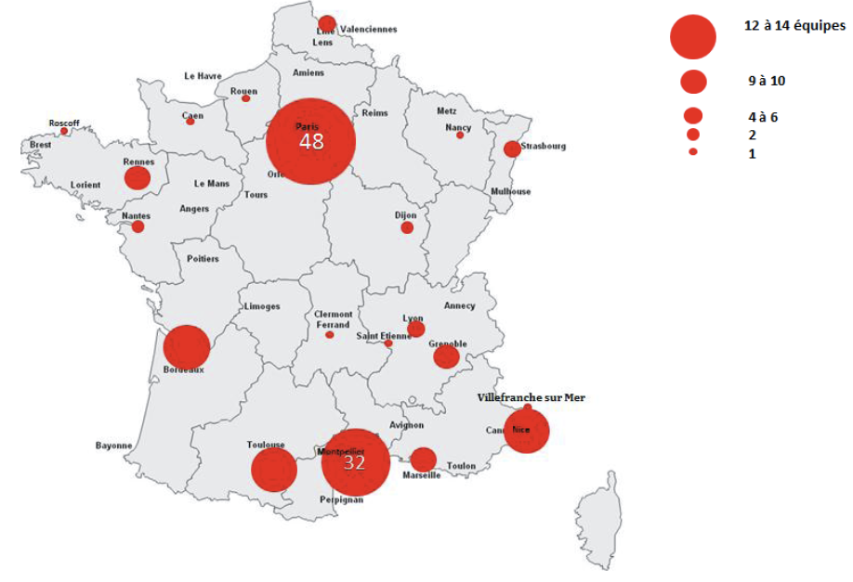





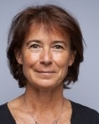

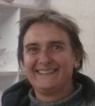
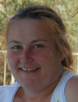
Autophagy/cell mechanics
-
Teams
Microenvironnement
-
-
Polarity/Traffic
-
Traffic/motor/cytoskeleton/adhesion/ cell division/host-pathogen interaction
Adhesion/differentiation
Rho GTPases/Tumor invasion
Adhesion/Migration
Membrane/Traffic
Adhesion/cell cycle

Slide 7
1 webconf/month
3-4 meetings/year
Evaluation Committees
Young Scientist Prize: Corinne Albigès-Rizo, Anne Blangy, Hélène Barelli, Arnaud Echard, Frank Lafont, Violaine Moreau, Franck Perez, Brigitte Sola
FRSV Thesis Prize : Véronique Baldin, Stéphanie Miserey-Lenkei
Grant Travel for Doc/Post-doct: Frédéric André, Véronique Baldin, René-Marc Mège, Stéphanie Miserey-Lenkei, Brigitte Sola
deadlines: 15 Mars ; 15 Juin ; 15 Septembre ; 15 Décembre
Meeting support: Arnaud Echard, Alexis Gautreau, Franck Perez
deadline : 31 Mars et 30 Septembre
Website contact: Grégoire Michaux, Violaine Moreau
Webmaster: Adriaan Oprins
Teaching contact: Ijsbrand Kramer
Secretary: Elysabeth Cortade, Atoutcom
Permanent members: Thierry Galli, Cécile Gauthier-Rouviere, Bernard Ducommun, Bruno Goud, Pierre Jurdic, Christian Sardet, Bernard Hoflack as former Présidents AND
Thierry Galli : Editor-in-chief of Biology of the Cell

Slide 8
Membership benefits
A quaterly newsletter « gazette » with updates on grant/award opportunities,
public policy briefings, meeting announcements, news of interest to the SBCF community
An annotated membership directory
Travel grants, poster prizes, annual young researcher prize
Financial support for meetings/workshops
Large diffusion of job opportunities (website + emailing list diffusion once a month)
Notes:
The ASCB Newsletter, published 11 times per year, provides information on funding opportunities, public policy, careers, meetings and other topics of interest

Slide 9
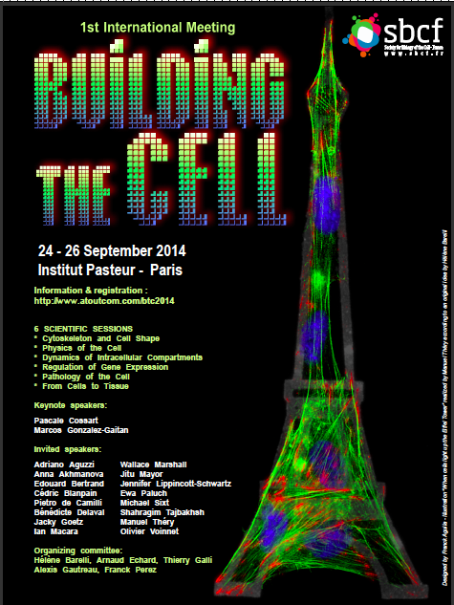
Meetings supported by SBCF in 2013-2014
5th Cell Adhesion Club meeting Marseille May 2014
17th Endo/Exocytosis Club conference May 2014
6th European Conference on Tetraspanins Lille June 2014
FEBS EMBO 2014 Paris September 2014
Cancer and Metabolism Nice September 2014
Building the cell Paris September 2014

Slide 10
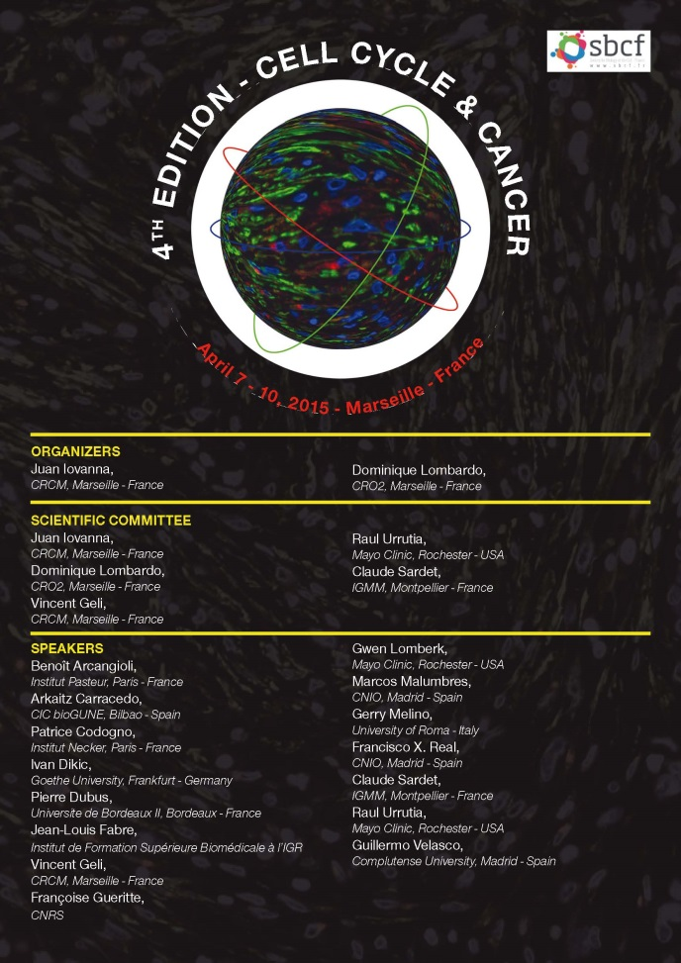
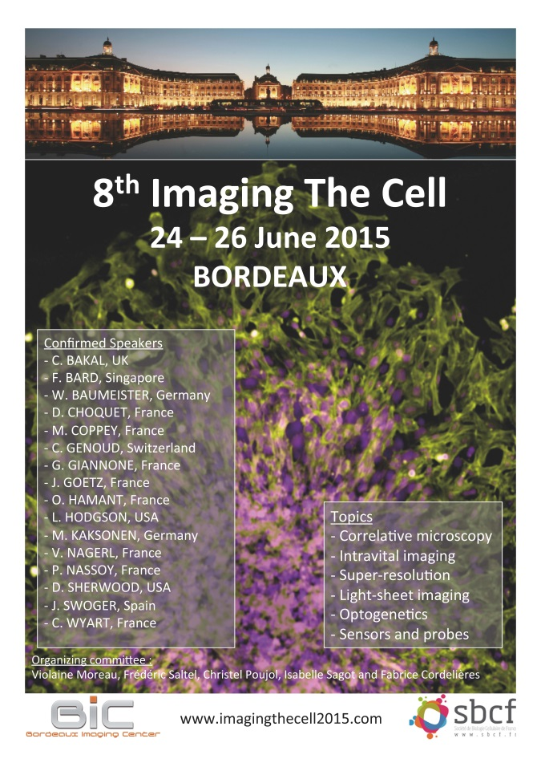
Upcoming meetings
Notes:
Funding for graduate students and postdocs to organize one-day local meetings at their institution. Discounted registration for the ASCB Annual Meeting.

Slide 11
Travel Grants 2013
For graduate students and post-doc SBCF members
Sessions:
January 15th, June 15th, September 15th, December 15th
80 candidates in 2013
10800 euros
12 travel grants in 2013

Slide 12

December 2014: SBCF at ASCB meeting
With
SBCF booth
SBCF session
Action with ITMO BCDE
Open positions in french labs
SBCF Advertisement
Opportunities for career development
Meeting point to discuss with french scientists
International Research and Training Exchange Fair
ASCB/SBCF Prizes

Slide 13
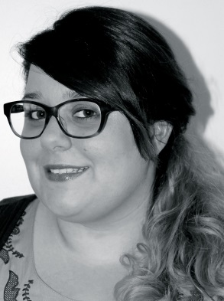
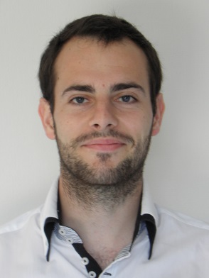
ASCB/SBCF prizes
Application each year before august 1er
See website(www.sbcf.fr) for application conditions
2014 Awardees
Julie Di Martino, PhD student
Cytoskeleton & Cancer group , Bordeaux
Discoidin domain receptor1 controls linear invadosome formation.
Ghislain Gillard, PhD student
Institut de Génétique et Développement , Rennes
E-cadherin apical sorting byu a p200/1P 1/clathrin/Rab-11 pathway during morphogenesis

Slide 14
16 candidates for SBCF Young Scientist Award in 2014
SBCF Young scientist Award 2015
5000 euros
Criteria:
-Be less than 35 years old
-Be author of one publication from your post-doc position
-Be SBCF member in a SBCF Team
-Be author of outstanding contributions in the field of cell biology
Send your CV + publication list + research activities (5 pages max)
before February 1rst 2015 at sbcf@atoutcom.com

Slide 15

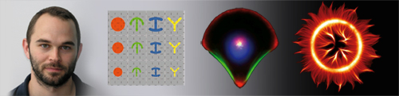
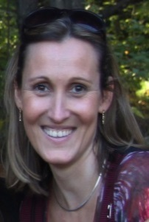

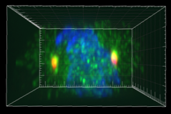
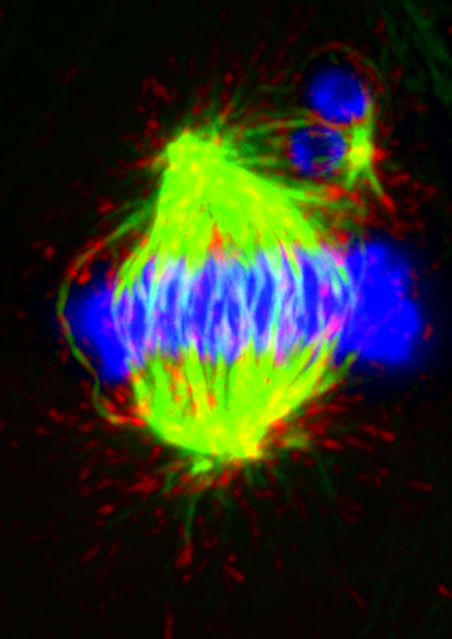
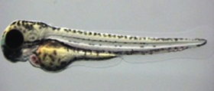
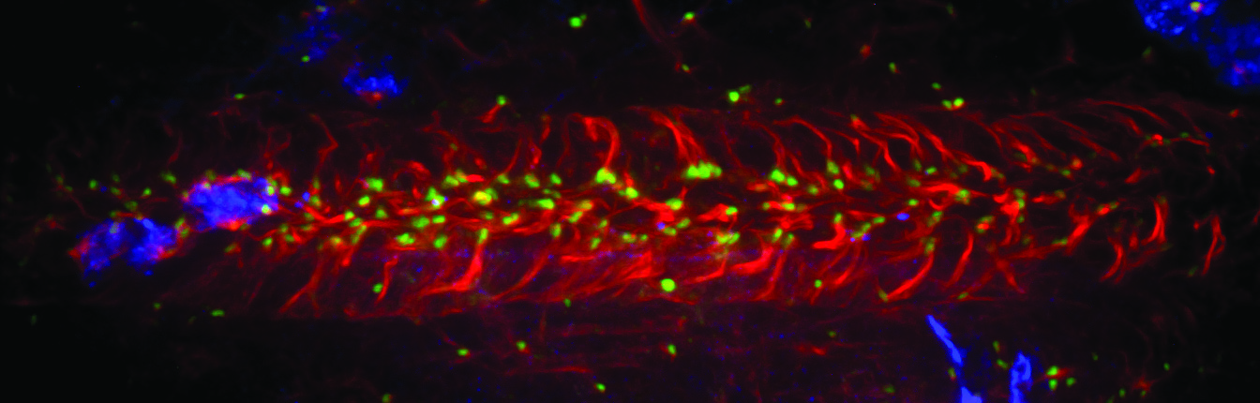

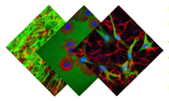
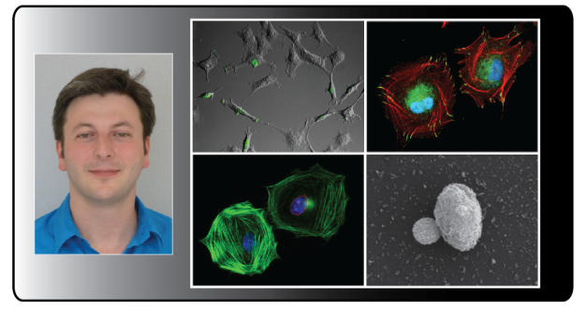
2011: Manuel Thery, Grenoble
« Physics of cytoskeleton
and morphogenesis »
2012: Bénédicte Delaval, Montpellier
« Centrosomes and ciliopathies »
2013: Jacky Goetz, Strasbourg
« Biomechanical remodelling
of the microenvironment »
2014: Christophe Guilluy, Nantes
« Strengthening the cell
from the cytoskeleton to the nucleus »

Slide 16


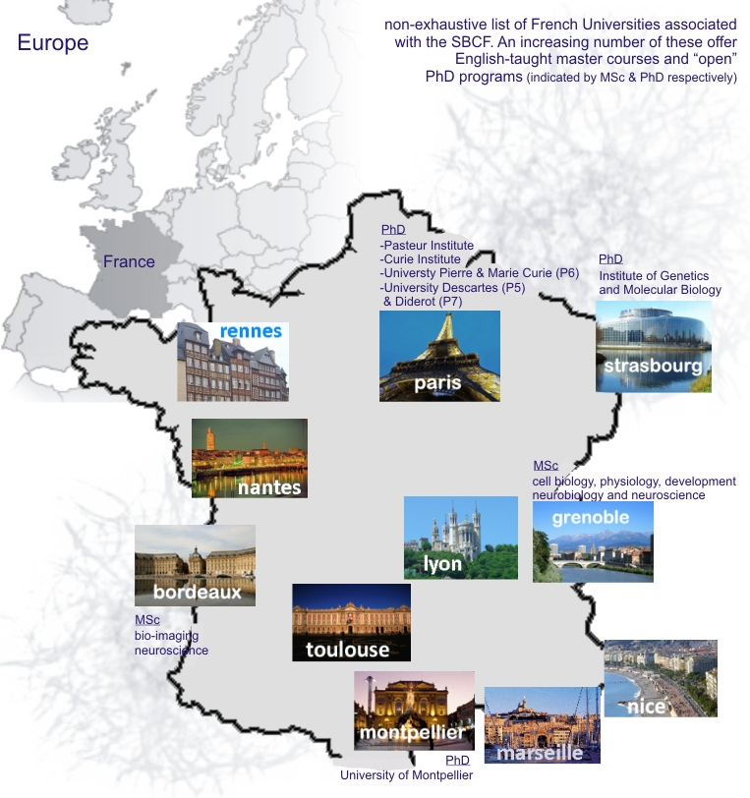
Teaching
Why study in France?
Campus France
-teaching-intensive undergraduate courses
-high quality education at affordable prizes
-many cities provide a broader student experience (social life, services, nutrition, culture and housing)
-english-taught master courses in a number of Universities
-world wide career prospects
Teaching contact: i.kramer@iecb.u-bordeaux.fr

Slide 17
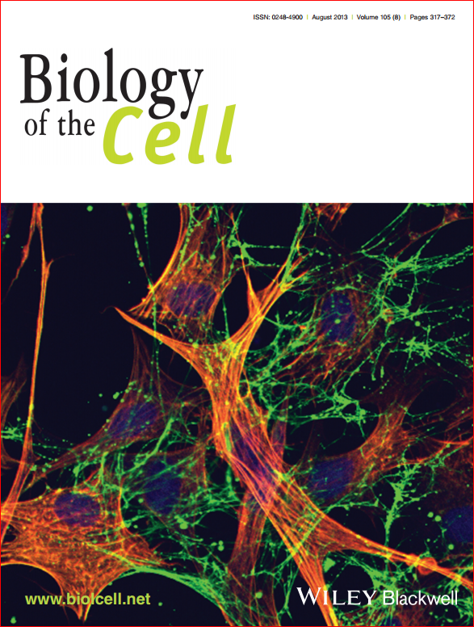
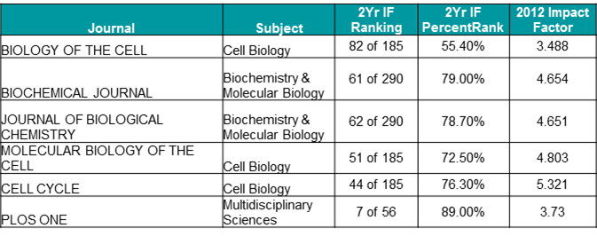
Biology of the Cell
Official journal of the French Society for Cell Biology & the French Society for Microscopy
Impact Factor of 3.8
Available in over 4,500 institutions world wide
Time from submission to first decision 24 days
Full Text app for iPad and iPhone coming soon
Special issues on Optogenetics, Epigenetics, Stem Cells, etc
More info at www.biolcell.net

Slide 20
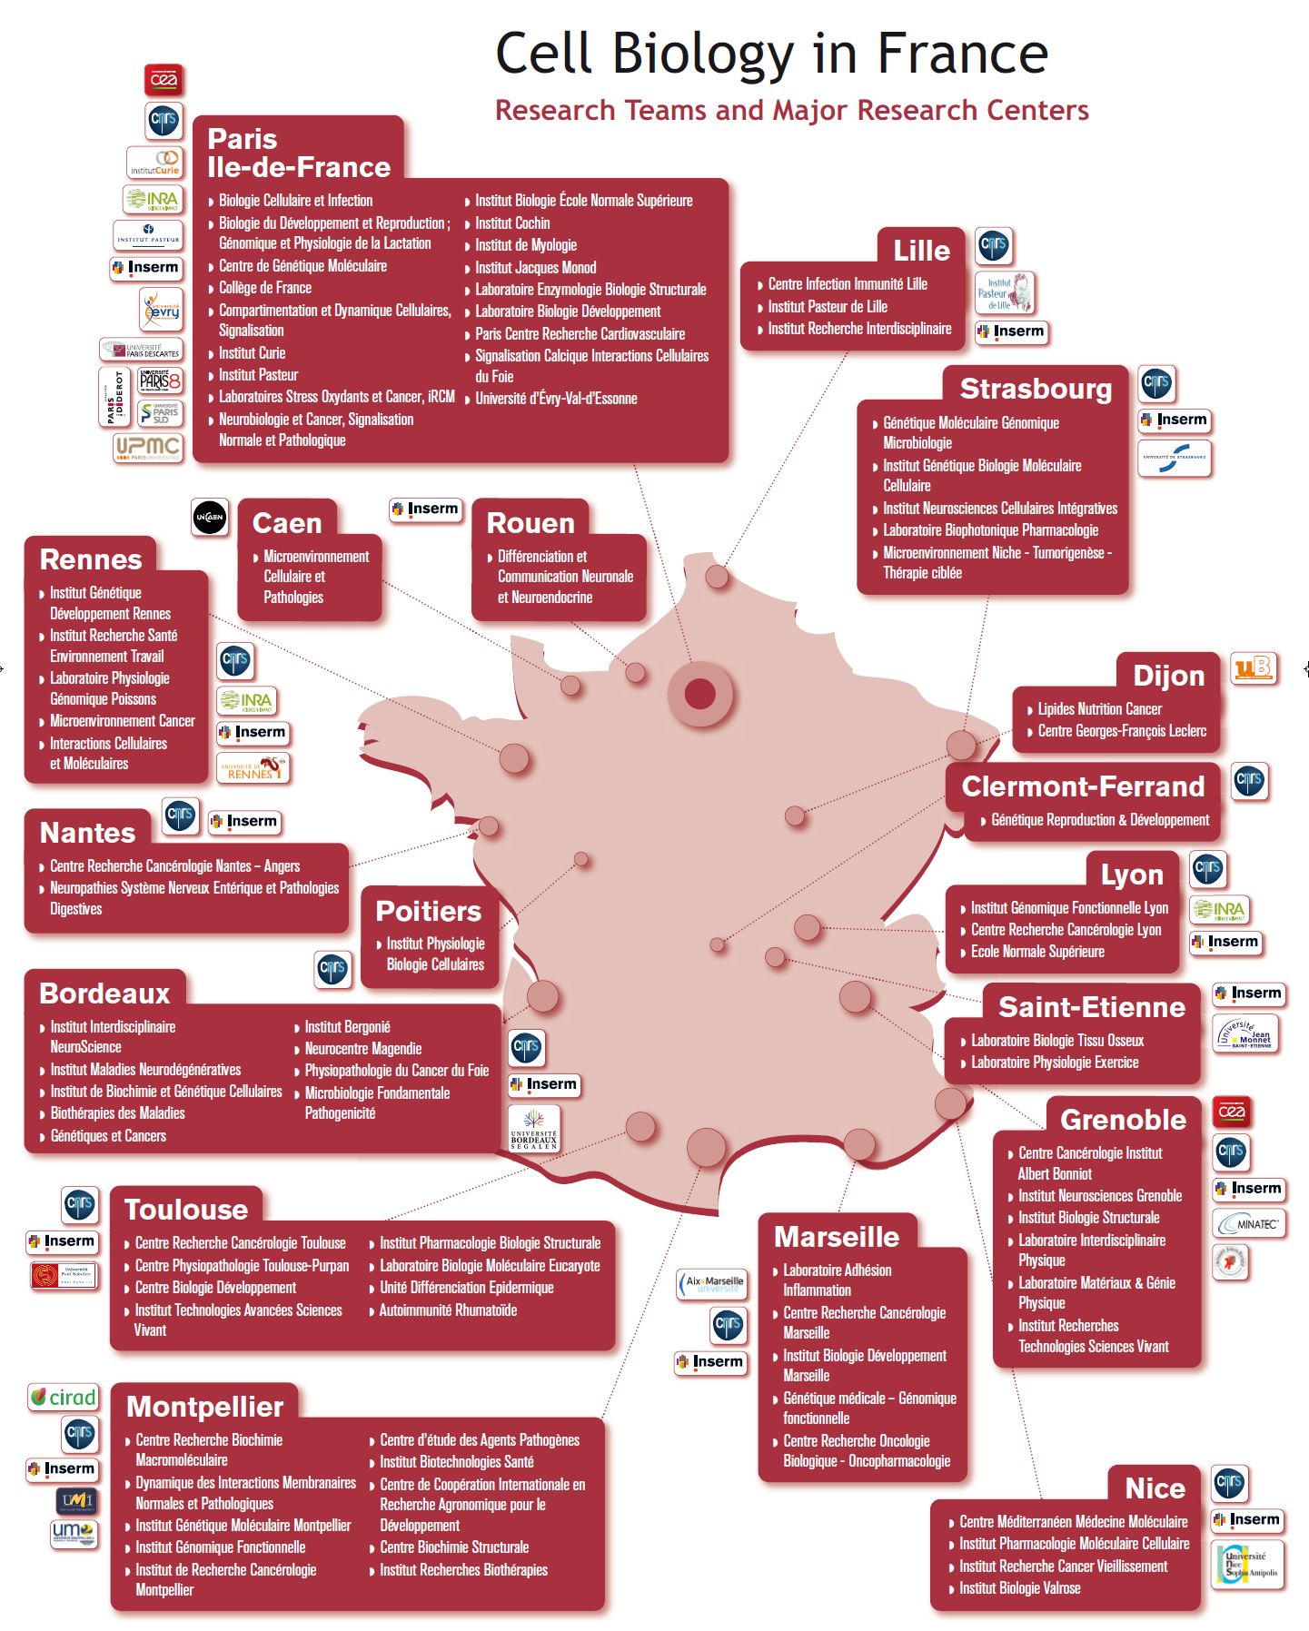

Slide 21
Our Missions
Advancing scientific discovery by stimulating partnerships
Publishing « Biology of the Cell »
Advocating sound research policies
Stimulating pedagogical innovations
Preparing learning documents
Promoting professional development
Promoting diversity in the scientific workforce
Notes:
We are dedicated to advancing scientific discovery, advocating sound research policies, improving education, promoting professional development, and increasing diversity in the scientific workforce
Opportunities to make your voice heard on national and international research funding and science policy issues
Hill Days to bring scientists face-to-face with their Representatives on Capitol Hill.
Public Policy Alerts provided in each issue of the ASCB Newsletter.

