Slide 1

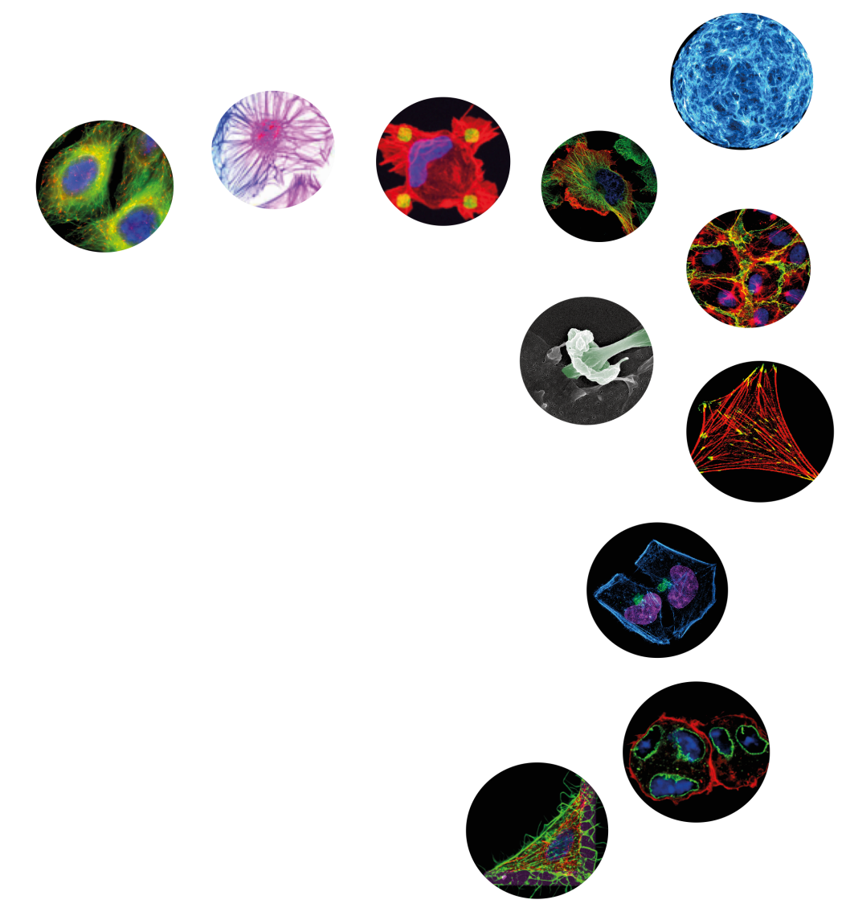
The French Society for Cell Biology
aims at promoting cell biology research
and education
www.sbcf.fr
free membership

Slide 2
14h-15h: Alphée Michelot,- Prix JC SBCF 2016- IBDM - CNRS, Marseille
"Dissecting Principles Governing Actin Assembly with Biomimetic Systems"
15h-15h45: Assemblée Générale SBCF
15h45-16h15: Pause
16h15-17h: Alexis Gautreau, - Ecole Polytechnique - CNRS, Saclay
"Branched Actin Networks in Cell Migration and Proliferation"

Slide 3

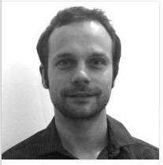
Alphée Michelot, Prix JC SBCF 2016
2015-Group Leader
IBDM – CNRS Marseille
2012-2015 CR CNRS
CEA Grenoble Equipe L. Blanchoin
2008-2012 Post-doctorat
UC Berkeley Drubin Lab
2004-2008 Doctorat
CEA Grenoble Equipe L. Blanchoin

Slide 4
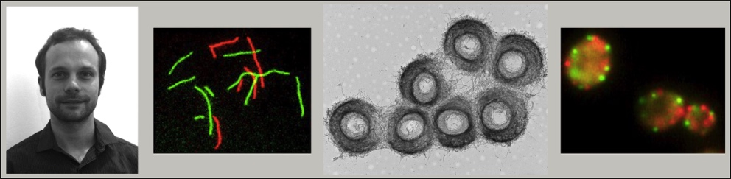
"Dissecting Principles Governing Actin Assembly with Biomimetic Systems”
Alphée Michelot
IBDM-CNRS, Marseille
Notes:
Funding for graduate students and postdocs to organize one-day local meetings at their institution. Discounted registration for the ASCB Annual Meeting.

Slide 6
The French Society for Cell Biology
aims at promoting cell biology research
and education
www.sbcf.fr
free membership

Slide 7

Founded in 1983
More than 1100 members
More than 230 affiliated research teams
Mailing list of more than 2000 contacts
www.sbcf.fr

Slide 8


OUR MISSIONS
Promoting cell biology research and education
Supporting conferences in cell biology
Sponsoring travel grants
Advancing scientific discovery by stimulating partnerships
Rewarding young researchers
Promoting professional development in cell biology
Advocating sound research policies
Publishing « Biology of the Cell »

Slide 9
Membership benefits
A newsletter with updates on grant/award opportunities,
public policy briefings, meeting announcements, news of interest to the SBCF community
An annotated membership directory
Travel grants, poster prizes, annual young researcher prize
Financial support for meetings/workshops
Large diffusion of job opportunities (website + emailing list diffusion once a month)
and Cell Biology meeting announcements
Notes:
The ASCB Newsletter, published 11 times per year, provides information on funding opportunities, public policy, careers, meetings and other topics of interest

Slide 10
1 Evaluation Committee for each SBCF action
Young Scientist Prize
deadline: February 15th
Grant Travel for Doc/Post-doct
deadlines: March 15th ; June 15th ; September 15th ; December 15th
Meeting support
deadlines : March 15th ; June 15th ; September 15th ; December 15th
Website contact: Grégoire Michaux, Violaine Moreau
Twitt ??
Webmaster: Adriaan Oprins
Teaching contact: Ijsbrand Kramer
Secretary: Elysabeth Cortade, Atoutcom
Notes:
The ASCB Newsletter, published 11 times per year, provides information on funding opportunities, public policy, careers, meetings and other topics of interest

Slide 11
1 webconf/month for the Executive board
and 3-4 meetings/year for the whole Council
Permanent members: Corinne Albiges-Rizo,
Thierry Galli
Cécile Gauthier-Rouviere
Bernard Ducommun
Bruno Goud
Pierre Jurdic
Christian Sardet
Bernard Hoflack as former Présidents
AND Thierry Galli : Editor-in-chief of Biology of the Cell

Slide 12
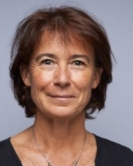
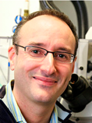

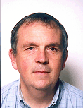
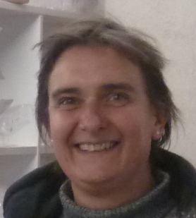
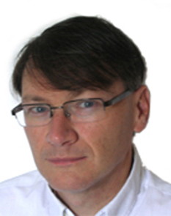
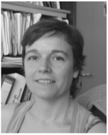
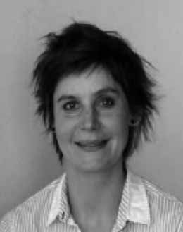
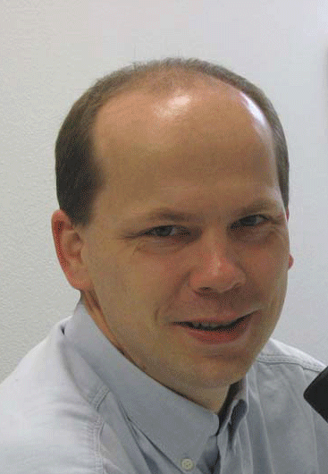
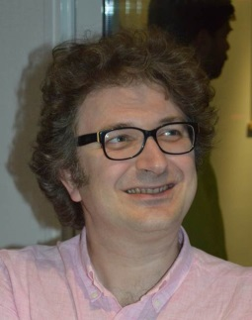
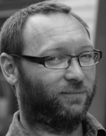
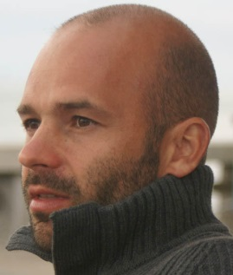
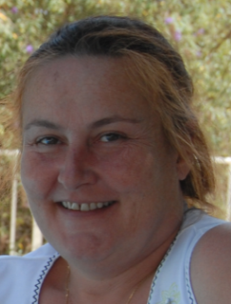
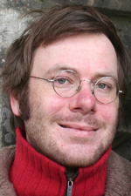
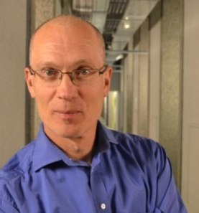
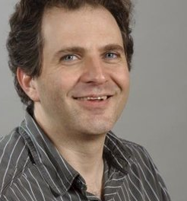
Previous SBCF Council
Executive board
President
Vice-President
Treasurer
Vice-Treasurer
Secretary
Vice-Secretary
C. Albiges-Rizo
A. Echard
H. Barelli
RM. Mège
A. Blangy
F. Lafont
Advisory board
V. Moreau
S. Miserey
-Lenkei
G. Michaux
A. Gautreau
V. Gache
J. Goetz
V. Baldin
J. Enninga
Education
Communication
Editor
Biology of the cell
I. Kramer
T. Galli

Slide 13
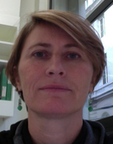
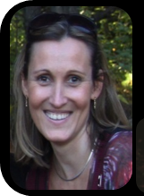
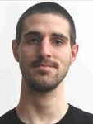
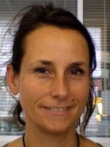
Newly elected
SBCF Council
Executive board
President
Vice-President
Treasurer
Vice-Treasurer
Secretary
Vice-Secretary
A. Echard
A. Blangy
H. Barelli
S. Miserey
-Lenkei
F. Lafont
M.H. Verlhac
Advisory board
V. Moreau
A. Gautreau
V. Gache
J. Goetz
J. Enninga
B. Delaval
R. Gaudin
F. Niedergang
Education
Communication
Editor
Biology of the cell
I. Kramer
T. Galli

Slide 14
MERCI CORINNE !
President of the SBCF for 3 years

Slide 15
2015 Actions of the SBCF

Slide 16
ASCB/ SBCF 2015
San Diego

Slide 17
ASCB/ SBCF 2015
SBCF booth 1328 and SBCF session
Action with ITMO BCDE
40 Open positions in french labs
SBCF Advertisement
Opportunities for career development
Meeting point to discuss with french scientists
ASCB/SBCF Prizes
Grand Merci à
Mireille Guyader, Inserm-USA Office,
Sylvie Robine, Aviesan ITMO BCDE,
Hélène Barelli, SBCF
Notes:
SBCF is an inclusive, international community of biologists studying the cell, the fundamental unit of life. We are dedicated to advancing scientific discovery, advocating sound research policies, improving education, promoting professional development, and increasing diversity in the scientific workforce

Slide 18
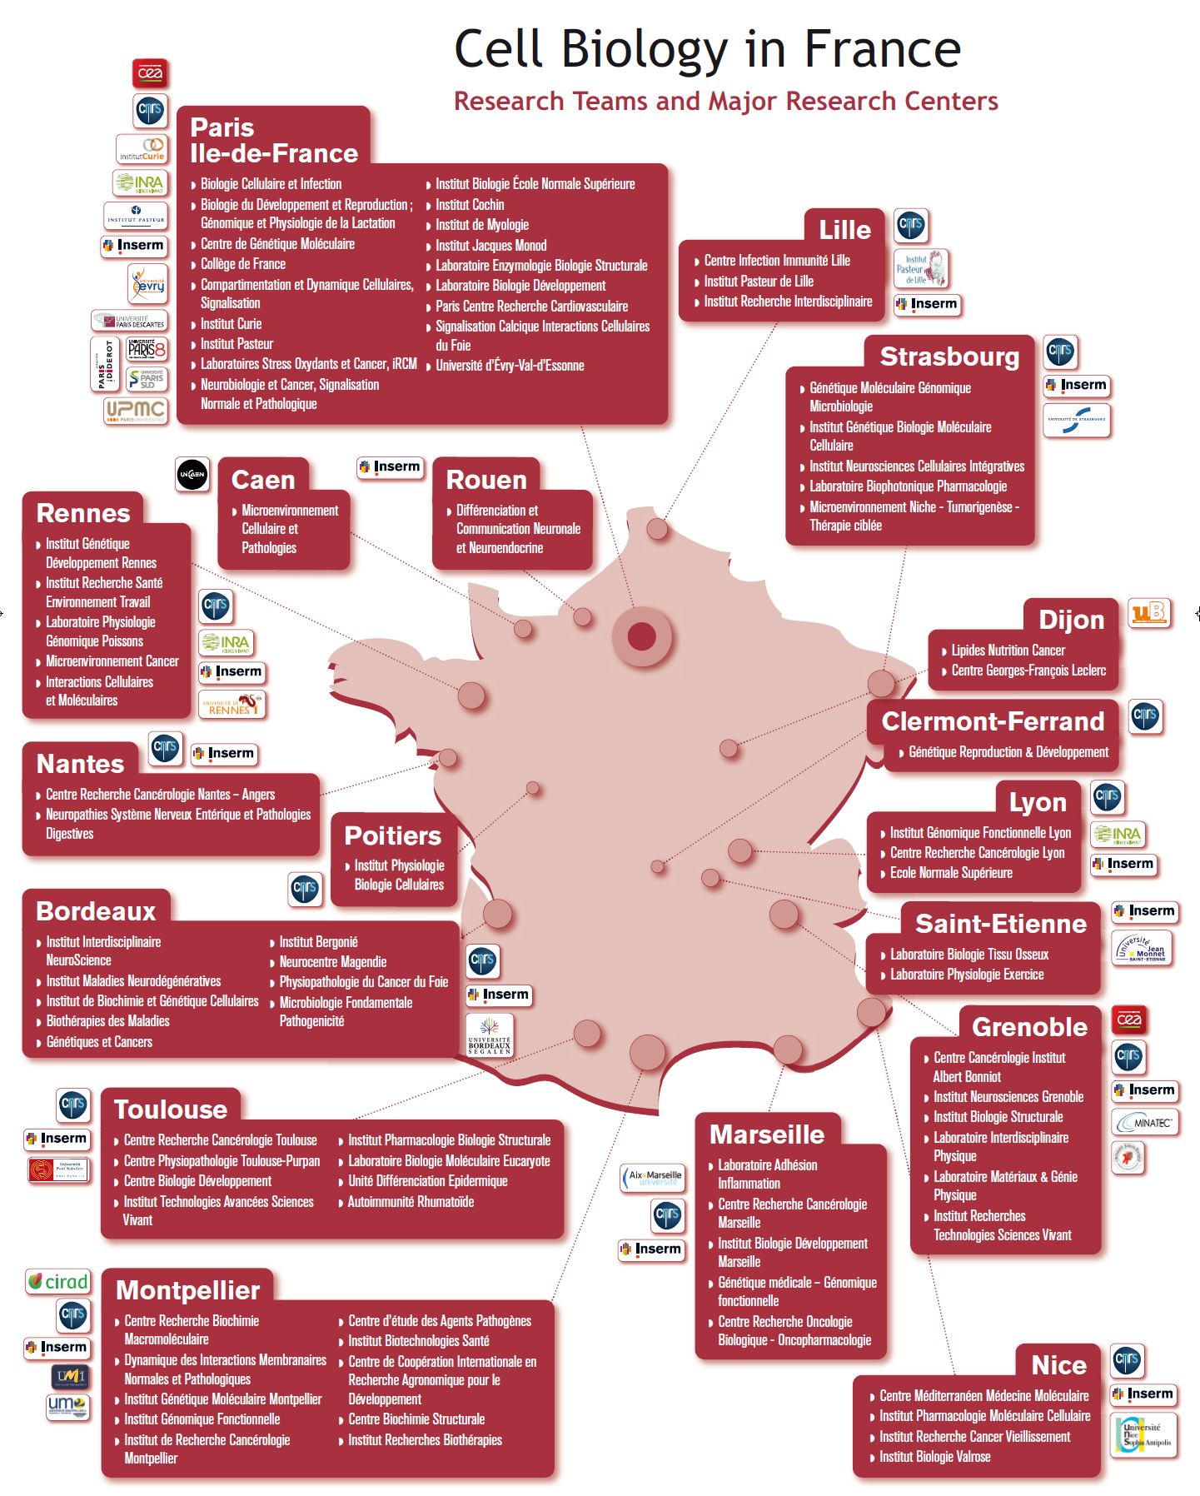

Slide 19


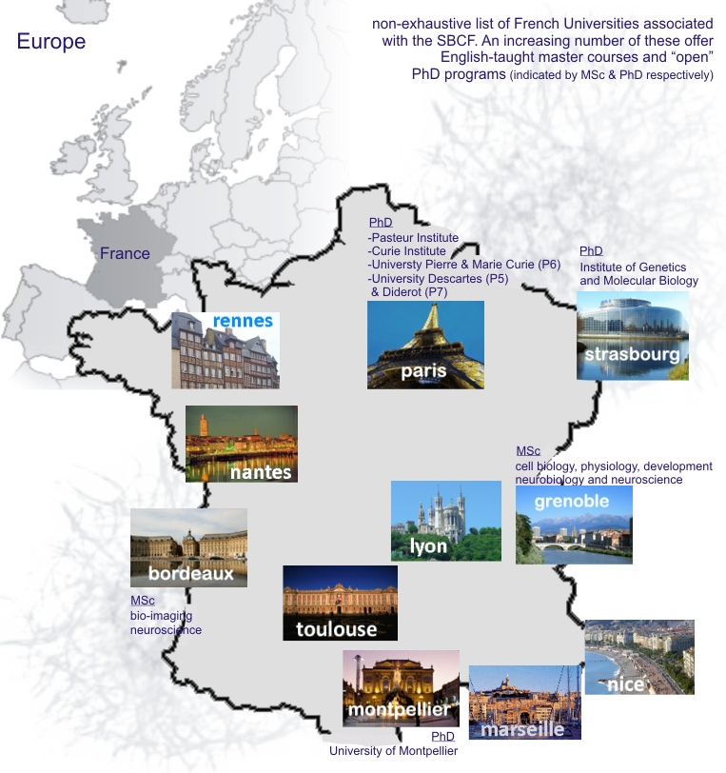
Teaching
Why study in France?
Campus France
-teaching-intensive undergraduate courses
-high quality education at affordable prizes
-many cities provide a broader student experience (social life, services, nutrition, culture and housing)
-english-taught master courses in a number of Universities
-world wide career prospects
Teaching contact: i.kramer@iecb.u-bordeaux.fr

Slide 20
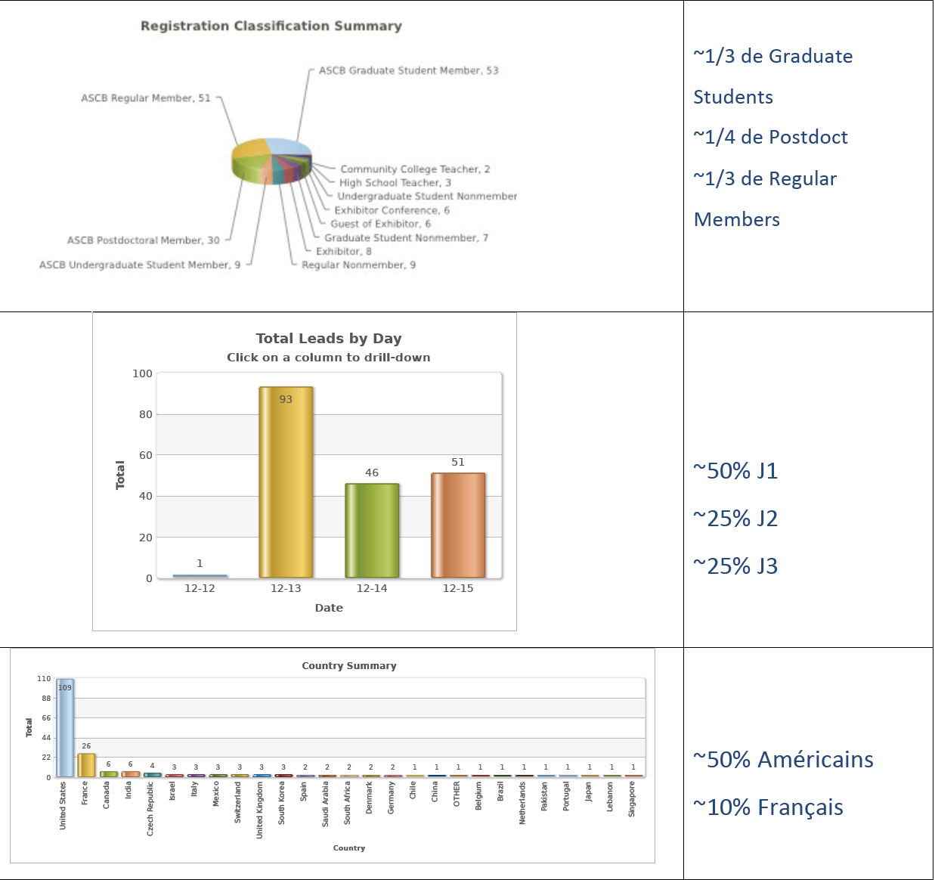
ASCB 2015
San Diego
About
200 visitors
Notes:
SBCF is an inclusive, international community of biologists studying the cell, the fundamental unit of life. We are dedicated to advancing scientific discovery, advocating sound research policies, improving education, promoting professional development, and increasing diversity in the scientific workforce

Slide 21
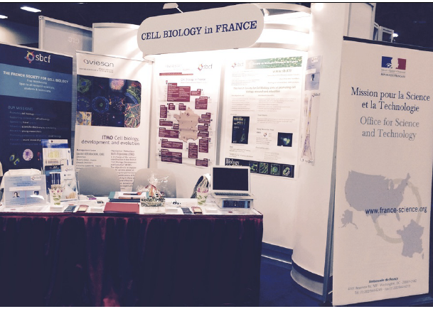
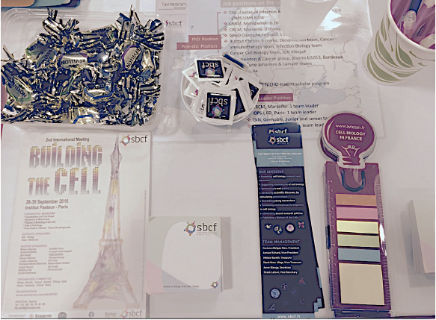
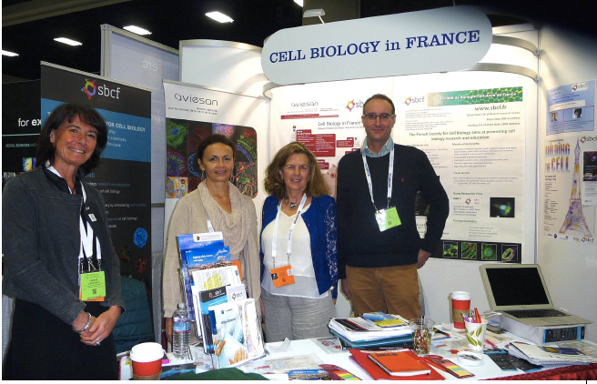
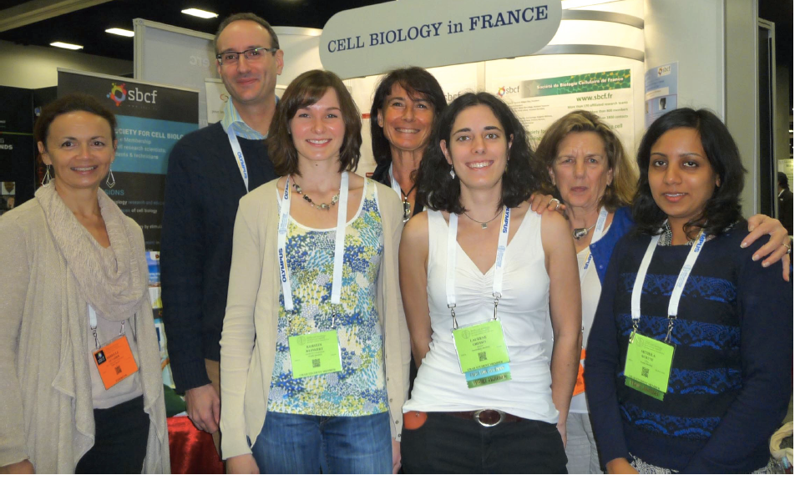

Slide 22
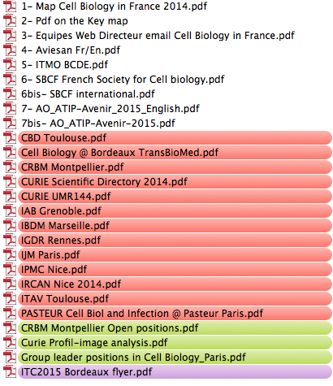
Contenu Clef USB
Participation d’une quinzaine
de centres
Notes:
SBCF is an inclusive, international community of biologists studying the cell, the fundamental unit of life. We are dedicated to advancing scientific discovery, advocating sound research policies, improving education, promoting professional development, and increasing diversity in the scientific workforce

Slide 23
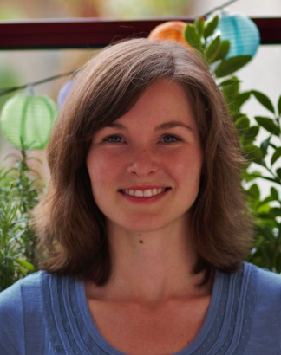
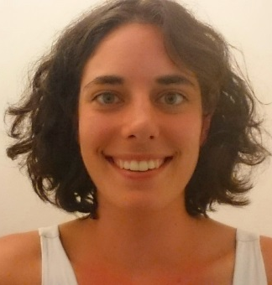
ASCB/SBCF prizes
Application each year before august 1^{rst}
See website (www.sbcf.fr) for application conditions
2015 Awardees
Kirsten Klinkert, PhD student poster B1101 Sunday
Membrane Traffic and Cell Division Lab, Paris
Rab35 GTPase couples cell division with initiation of epithelial apico-basal polarity
Laurene Gressin, PhD student poster B406 Monday
Physics of cytoskeleton and morphogenesis , Grenoble
Architecture dependence of actin filament network disassembly

Slide 24
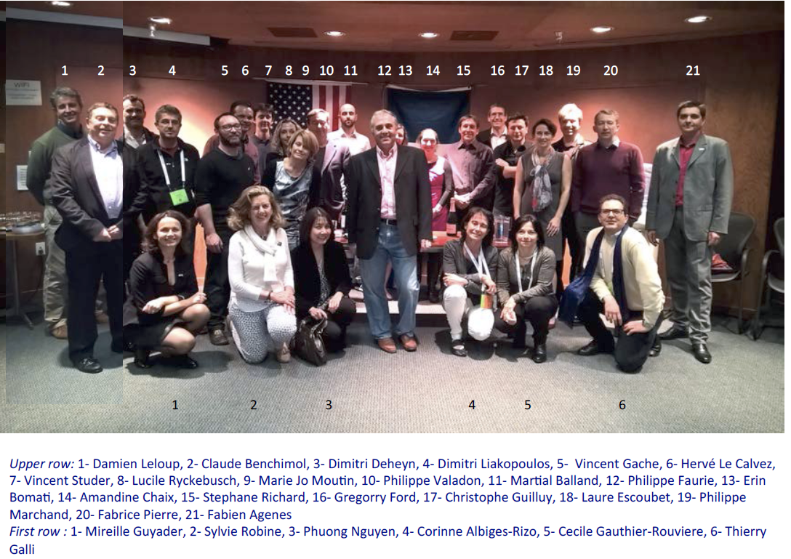

Slide 25
« Profession de foi pour élections »

Slide 26
Meetings organized by the SBCF

Slide 27
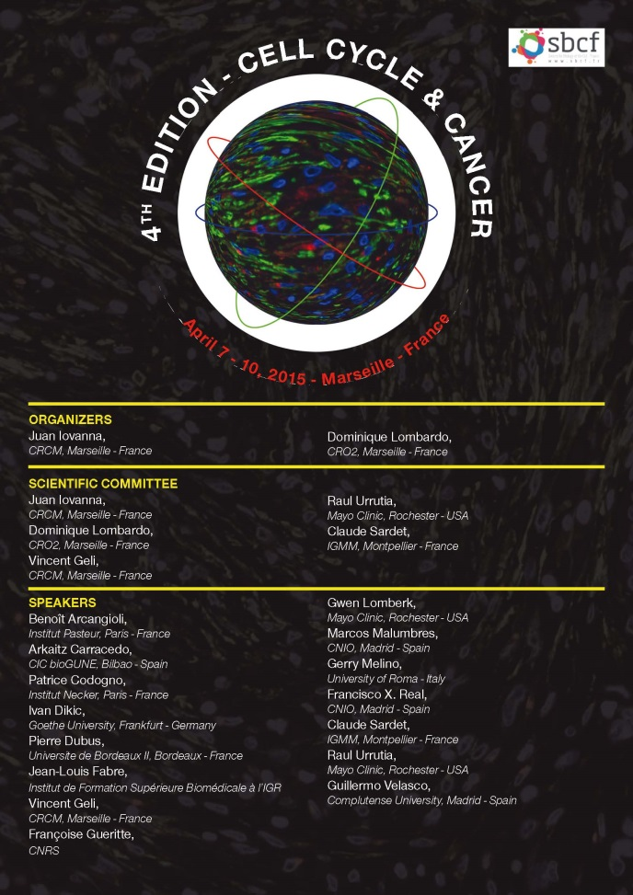
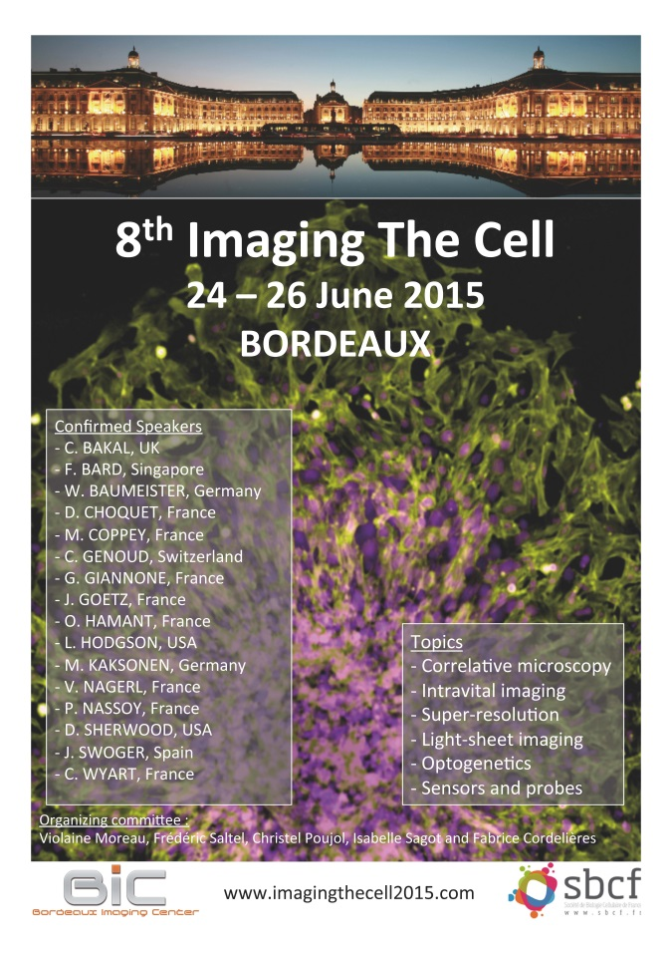
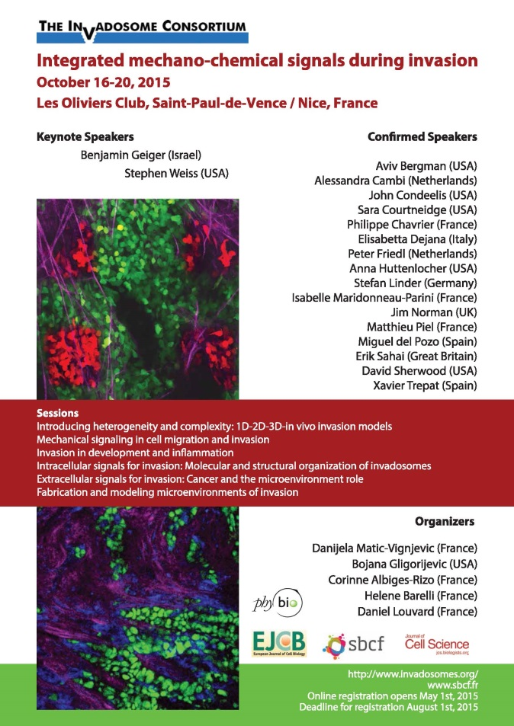
Supported SBCF meetings 2015
April 2015/80p/40 k€ June 2015/ 125p/80k€ Oct 2015/170p/140 k€
Violaine
Corinne, Daniela, Hélène
Notes:
Funding for graduate students and postdocs to organize one-day local meetings at their institution. Discounted registration for the ASCB Annual Meeting.

Slide 28

Upcoming meetings 2016/2017
July 1st Paris: « Current challenges in cell –cell communication »
AVISIAN/ITMO BCDE et SBCF
Deadline : June 20
https://cellcomm.sciencesconf.org/
Notes:
Funding for graduate students and postdocs to organize one-day local meetings at their institution. Discounted registration for the ASCB Annual Meeting.

Slide 29
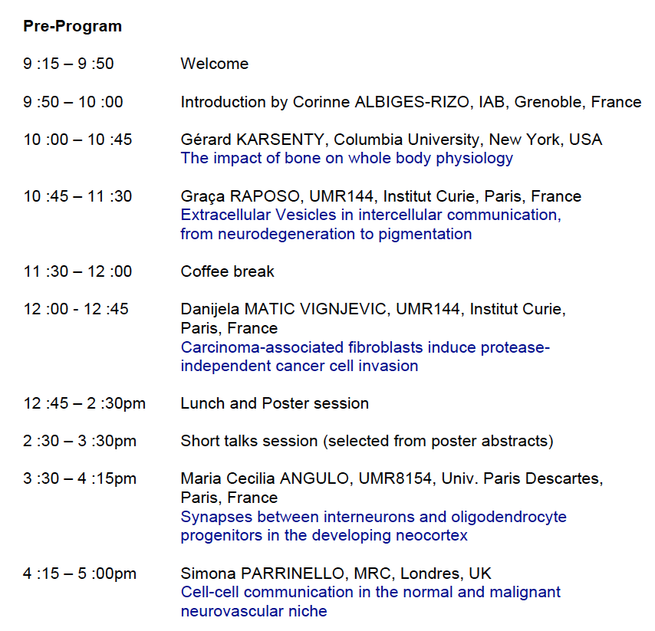
Notes:
Funding for graduate students and postdocs to organize one-day local meetings at their institution. Discounted registration for the ASCB Annual Meeting.

Slide 30
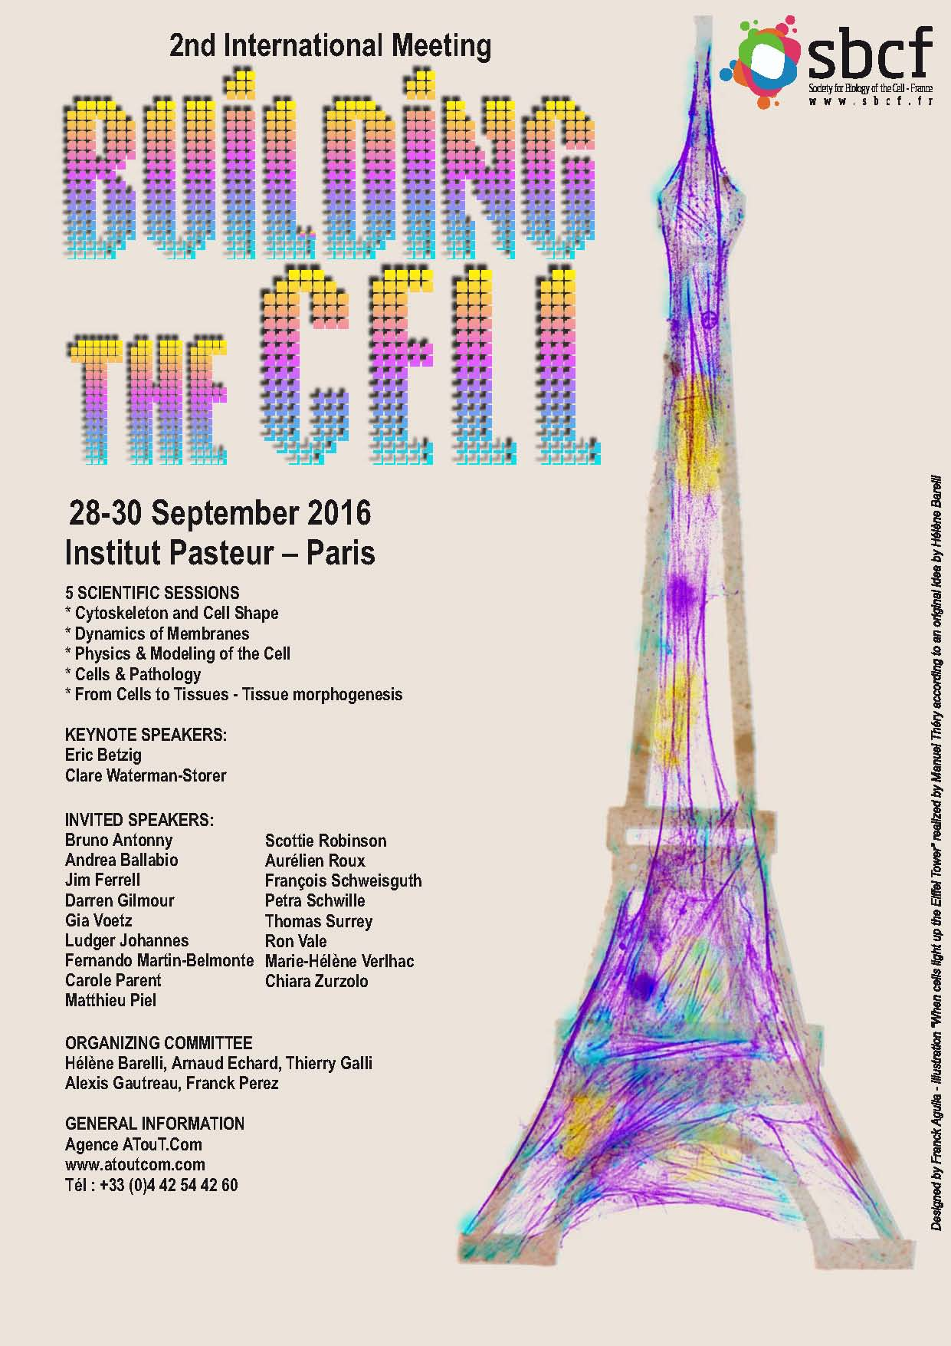
Upcoming meetings 2016/2017
28-30 September 2016:
« Building the Cell »
Paris -Institut Pasteur
Antonny, Ballabio, Betzig, Ferrell, Gilmour, Johannes,
Li, Martin-Belmonte, Mehlen, Parent, Piel, Robinson,
Roux, Schweisguth, Schwille, Surrey, Vale, Verlhac,
Zurzolo
Google: « building the cell 2016 »
Register before July 14 for best prices
(250-350€)
Notes:
Funding for graduate students and postdocs to organize one-day local meetings at their institution. Discounted registration for the ASCB Annual Meeting.

Slide 31
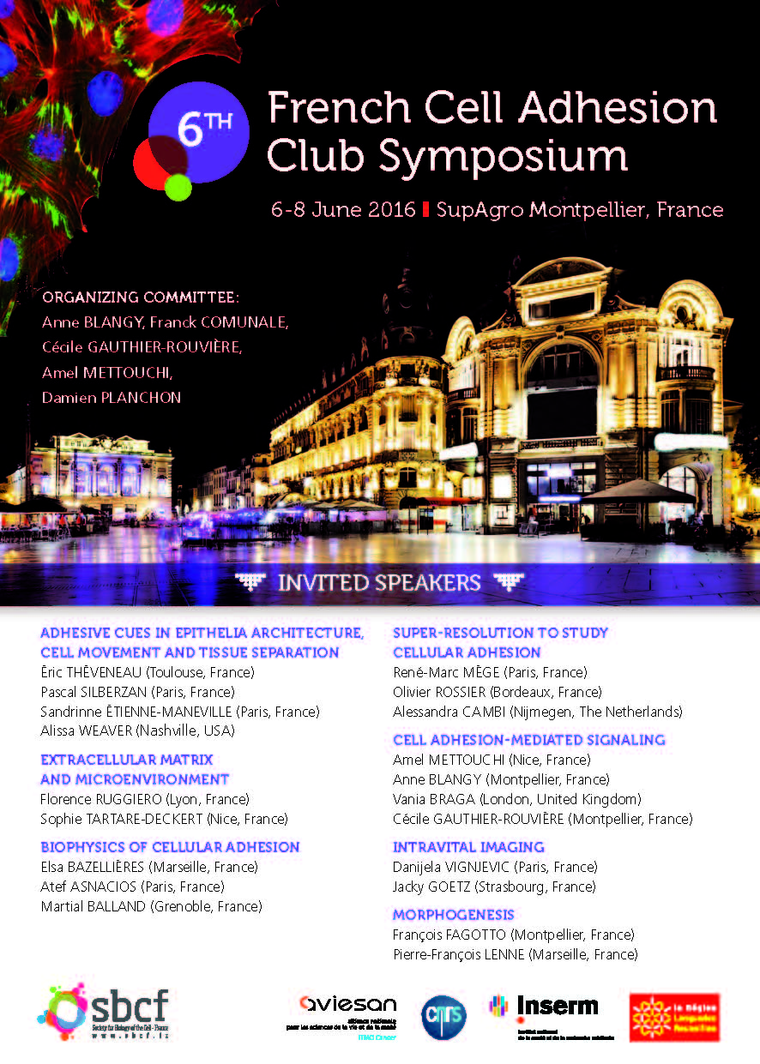
Upcoming meetings 2016/2017
6-8 June 2016, Montpellier
« 6th Cell Adhesion Meeting »
(C. Gauthier, A. Blangy SBCF)
http://sites.altilab.com/cacs
Notes:
Funding for graduate students and postdocs to organize one-day local meetings at their institution. Discounted registration for the ASCB Annual Meeting.

Slide 32
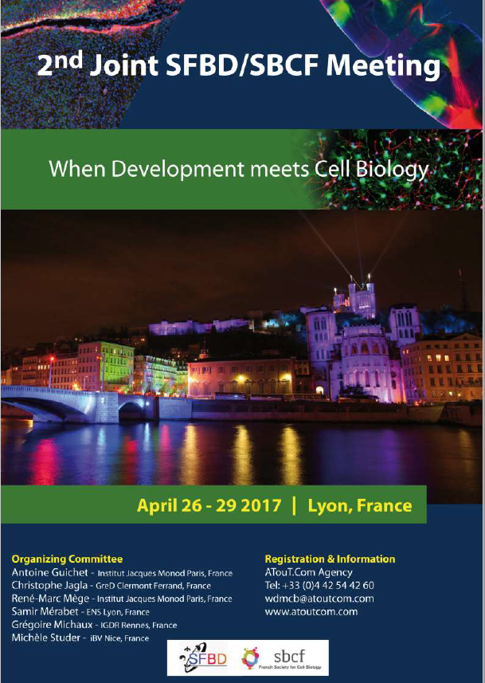
Upcoming meetings 2016/2017
Joint meeting SFBD/SBCF (250 p)
April 2017, Lyon
(RM Mège, G. Michaux SBCF)
Notes:
Funding for graduate students and postdocs to organize one-day local meetings at their institution. Discounted registration for the ASCB Annual Meeting.

Slide 33
Upcoming meetings 2016/2017
« Imaging the Cell 2017»
June 2017, Rennes
(S. Dutertre, G. Michaux SBCF)
Notes:
Funding for graduate students and postdocs to organize one-day local meetings at their institution. Discounted registration for the ASCB Annual Meeting.

Slide 34
Meetings supported by the SBCF
in 2015

Slide 35
Meetings supported by the SBCF in 2015
= 7 000 €
18ème Club Exo-Endo Evian May 2015
Journées du Réseau France Microtubule July 2015
International Autophagy conference Lille october 2015
French society for Angiogenesis Paris September 2015
Nucleo-cytoplasmic traffic Feliu de Guixol Spain September 2015
Hands-on training course on applications
of cellular imaging to biological questions Montp. Jan 2016
Shaping Life - SFBD Meeting May 2016
Autophagy days CFATG conference Bordeaux sept 2016
19ème Club Exo-Endo Carry May 2015
Notes:
Funding for graduate students and postdocs to organize one-day local meetings at their institution. Discounted registration for the ASCB Annual Meeting.

Slide 36
2015 Travel fellowships
for students and post-docs

Slide 37
22 Bourses SBCF : 16 200 €
2 bourses ITMO/SBCF : 1 000 €
1. Antkowiak Adrien Doctorant (Bernard Payrastre) Italie
2. Daynac Mathieu Post Doc ISSCR (Martial Ruat) Stockholm – Suede
3. Costache Vlad Post Doc (Alex McDougal) France
4. Gabel Marion Doctorant (Gasman Stéphane / Vitale Nicolas) Pays Bas
5. Grassart Alexandre Post Doctorant (Nathalie Sauvonnet) France
6. Pinot Mathieu Post Doctorant (Roland Le Borgne) Mandelieu
7. Rouvière Jérôme Doctorant (Valérie Doye) Grèce
8. Burute Mithilda Doctorant (Manuel Thery) ITMO ASCB
9. Gressin Laurène Doctorant (Laurent Blanchoin) ASCB/SBCF
10. Klinkert Kerstin Doctorant (Arnaud Echard) ASCB/SBCF
12. Kowal Joanna Doctorant (Clotilde Thery) ASCB
13. Krndija Denis Post Doctorant (Danijela Vignjevic) ASCB
14. Santos Carina Post Doctorant (Bruno Goud) ASCB
15. Taulet Nicolas Post Doctorant (Bénédicte Delaval) ITMO ASCB
16. Al Jord Adel Doctorant (Nathalie SPASSKY) USA
17. Dillard Pierre Post Doctorant (Pierre Bongrand / Pierre-henri Puech)
18. Planchon Damien Doctorant (Cécile Gauthier Rouvière) ASCB
19. Daussy Coralie Doctorant (Martine Biard-Piechaczyk) USA
20. Mercat Benjamin Doctorant (Jacques Pécréaux) USA
21. Yekaterina Miroshnikova, Post-Doctorante, UJF - Grenoble
22. Elodie Henriet Doctorante, CEA - Toulouse Invadosome meeting
23. Nisha Mohd Rafi Post-Doctorante, National University of Singapore Invadosome meeting
24. Julie Di Martino Post-Doctorante, INSERM Gref – Bordeaux Invadosome meeting

Slide 38
SBCF Young Scientist Award 2016 5000 euros
Criteria:
-Be less than 35 year old
(+1 year child for women and adaptation for parental leave)
-Be an author of one publication from your post-doc position
-Be SBCF member in a SBCF Team
-Be an author of outstanding contributions in the field of cell biology
Information :
-Deadline: 1er February
-Selection: 1er round end feb and 2nd round mid-march
WWW.SBCF.FR
Notes:
Funding for graduate students and postdocs to organize one-day local meetings at their institution. Discounted registration for the ASCB Annual Meeting.

Slide 39
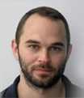

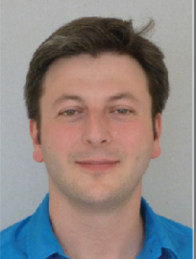
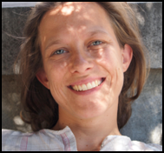
Prix Jeune Chercheur SBCF, since 2011
2011: Manuel Thery, Grenoble
« Physics of cytoskeleton and morphogenesis »
2012: Bénédicte Delaval, Montpellier
« Centrosomes et ciliopathies »
2013:Jacky Goetz, Strasbourg
« Biomechanical remodeling of the microenvonment »
2014: Christophe Guilluy, Nantes
« Mechanotransduction: Strengthening the cell from the cytoskeleton to the nucleus »
2015: Alice Meunier, Paris
« Centriole amplification in multiciliated cells »
2016: Alphée Michelot, Marseille
« Dissecting Principles Governing Actin Assembly with Biomimetic Systems »
Notes:
Funding for graduate students and postdocs to organize one-day local meetings at their institution. Discounted registration for the ASCB Annual Meeting.

Slide 40
28 000 euros distributed in 2015 by the SBCF
… free membership

Slide 41
« Biology of the Cell »
the journal of the SBCF and the SFμ

Slide 42

Biology of the Cell
Official journal
of the French Society for Cell Biology
& the French Society for Microscopy
Impact Factor of 3.9
Available in over 4,500 institutions world wide
Time from submission to first decision 24 days
More info at www.biolcell.net
Journal | Subject | 2Yr IF Ranking | 2Yr IF PercentRank | 2013 IF
BIOCHEMICAL JOURNAL | Biochemistry & Molecular Biology | 61 of 291 | 79.20% | 4.779
BIOLOGY OF THE CELL | Cell Biology | 78 of 185 | 57.90% | 3.872
JOURNAL OF BIOCHEM | Biochemistry & Molecular Biology | 126 of 291 | 56.70% | 3.073
MOLECULAR BIO OF THE CELL | Cell Biology | 59 of 185 | 68.30% | 4.548
CELL CYCLE | Cell Biology | 51 of 185 | 72.60% | 5.006
PLOS ONE | Multidisciplinary Sciences | 8 of 55 | 87.00% | 3.534

Slide 43
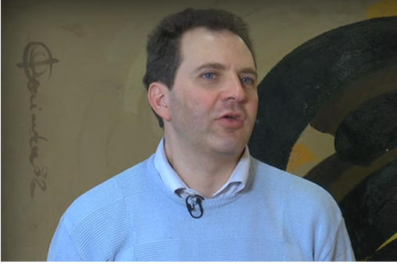
THANK YOU THIERRY FOR ALL THESE YEARS AT THE SERVICE OF THE JOURNAL AND THE SBCF !

Slide 44
Rapport financier 2015
Hélène Barelli, Trésorière
Notes:
Funding for graduate students and postdocs to organize one-day local meetings at their institution. Discounted registration for the ASCB Annual Meeting.

Slide 45
 | Bilan SBCF
 | INCOME
 | 2014
BOC royalties Wiley | 54 214 €
Carl Zeiss contrat | 3 000 €
Total Congrès dont subvensions | 60 228 €
Autres produits financiers | 1 895 €
Subventions | 4 514 €
TOTAL des prod. d'exploitation | 123 851 €
 | 2015
BOC royalties Wiley | 56 475 €
Carl Zeiss contrat | 3 000 €
Total Congrès dont subvensions | 150 412 €
Autres produits financiers | 2 659 €
Subventions | 19 230 €
TOTAL des prod. d'exploitation | 231 776 €
Notes:
Funding for graduate students and postdocs to organize one-day local meetings at their institution. Discounted registration for the ASCB Annual Meeting.

Slide 46
 | Bilan SBCF | AG SBCF 3 Juin 2016
 | DEPENSES
 | 2014
Prest.services | 7200
Fournitures/divers | 1302
Honoraires/Publicité | 6671
Bureau/Conseil | 6842
Frais Congrès | 50639
Soutien Congrès | 6333
Cabinet comptable | 3800
Bourses et Prix | 27843
Charges | 2567
Total Expenses | 113197
 | 2015
Prest.services | 7200
Fournitures/divers | 1407
Honoraires/Publicité | 6427
Bureau/Conseil | 7260
Frais Congrès | 133710
Soutien Congrès | 4500
Cabinet comptable | 1800
Bourses et Prix | 19900
Charges | 11167
Total Expenses | 193371
Notes:
Funding for graduate students and postdocs to organize one-day local meetings at their institution. Discounted registration for the ASCB Annual Meeting.

Slide 47
Bilan SBCF
PROFIT/LOSS SUMMARY
 | 2014 | 2015
Total income | 121 837 | 231 776
Total expenses | 113 197 | 193 371
Total profit (or loss) | 8 640 € | 38 405 €
Notes:
Funding for graduate students and postdocs to organize one-day local meetings at their institution. Discounted registration for the ASCB Annual Meeting.

Slide 48
Notes:
Funding for graduate students and postdocs to organize one-day local meetings at their institution. Discounted registration for the ASCB Annual Meeting.

Slide 49
"Branched Actin Networks in Cell Migration and Proliferation"
Alexis Gautreau
Ecole Polytechnique – CNRS , Saclay
Notes:
Funding for graduate students and postdocs to organize one-day local meetings at their institution. Discounted registration for the ASCB Annual Meeting.

Slide 50
Notes:
Funding for graduate students and postdocs to organize one-day local meetings at their institution. Discounted registration for the ASCB Annual Meeting.

Slide 51
Bilan Meetings SBCF 2015
 | Particip. | inscription | SPONSORING | DEPENSES | RECETTES | BILAN
CCC Marseille | 32+12 | 8 816 HT 10 580 TTC | 22 000 HT | 29 810 HT 33 448 TTC | 30 743 HT 33 623 TTC | + 924 HT + 174 TTC
ItC Bordeaux
Invasion St Paul de Vence | 128+28 | 81 350 TTC | 44 892 TTC | 107 487 HT 124 232 TTC | 127 442 TTC | +3 210 TTC
+ 20 700 TTC
Frais d’agence (gestion participants)/signalétique/ communication : 10 000 HT/ 12 500 TTC

Slide 52
Bourses SBCF : 16 200 €
Mars 2015
Adrien Antkowiak, Doctorant, Gordon Conference - Italie. Équipe Bernard Payrastre
Mathieu Daynac, Post-doctorant, ISSCR - Suède. Équipe Martial Ruat
Juin 2015
Vladimir Costache, Post-doctorant, Quantitative Biology of Signaling - France. Équipe Alex Mc Dougall
Marion Gabel, Doctorante, 8th Annexins Conférence - Pays Bas. Équipe Stéphane Gasman
Alexandre Grassart, Post-Doctorant, EMBO Conférence - France. Équipe Nathalie Sauvonnet
Mathieu Pinot, Post-Doctorant, EMBO Conférence - France. Équipe Roland Le Borgne
Jérôme Rouvière, Doctorant, EMBO Conférence - Grèce. Équipe Valérie Doye
Septembre 2015
Adel Al Jord, Doctorant, AACR - USA, Équipe Nathalie Spassky
Pierre Dillard, Post-Doctorant, ASCB – USA, Équipe Pierre Bongrand
Damien Planchon, Docotrant, ASCB – USA, Équipe Cécile Gauthier Rouvière
Décembre 2015
Coralie Daussy, Doctorante, Gordon Conference – USA, Équipe Martine Biard-Piechaczyk
Benjamin Mercat, Biophysical Society Meeting – USA, ÉquipeJacques Précreaux

Slide 53
Bourses ASCB-SBCF Juillet 2015
Prix ASCB : Kerstin Klinkert, Doctorante, Équipe Arnaud Échard
Laurène Gressin, Doctorante, Équipe Laurent Blanchoin
Bourses SBCF : Joanna Kowal, Doctorante, Équipe Clotilde Thery
Denis Krndija, Post-Doctorant, Équipe Danijela Vignjevic
Carina Santos, Post-Doctorante, Équipe Bruno Goud
Bourses ITMO : Mithilda Burute, Doctorante, Équipe Manuel Thery
Nicolas Taulet, Post-Doctorant, Équipe Bénédicte Delaval
Bourses Invadosome 2015
Yekaterina Miroshnikova, Post-Doctorante, UJF - Grenoble
Elodie Henriet, Doctorante, CEA - Toulouse
Nisha Mohd Rafiq, Post-Doctorante, National University of Singapore
Julie Di Martino, Post-Doctorante, INSERM Gref - Bordeaux

Slide 54
Récapitulatif - Attribution des Bourses
Bourses SBCF - Mars 2015
Antkowiak | Adrien | 600€
Daynac | Mathieu | 600€
Bourses SBCF - Juin 2015
Costache | Vlad | 600€
Gabel | Marion | 600€
Grassart | Alexandre | 600€
Pinot | Mathieu | 1 000€
Rouvière | Jérôme | 600€
Bourses SBCF - Septembre 2015
Al Jord | Adel | 1000€
Dillard | Pierre | 1000€
Planchon | Damien | 1000€
Bourses SBCF - Décembre 2015
Daussy | Coralie | 1000€
Mercat | Benjamin | 1000€
Bourses ASCB 2015
Burute | Mithilda | 500€ - ITMO
Gressin | Laurène | 1000€ ASCB/SBCF
Klinkert | Kerstin | 1000€ ASCB/SBCF
Kowal | Joanna | 1000€ - SBCF
Krndija | Denis | 1000€ - SBCF
Santos | Carina | 1000€ - SBCF
Taulet | Nicolas | 500€ - ITMO
Bourses Congrès Invadosome Octobre 2015
Miroshnikova | Yekaterina | 400€ - SBCF
Henriet | Elodie | 400€ - SBCF
Mohd Rafiq | Nisha | 400€ - SBCF
Di Martino | Julie | 400€ - SBCF
TOTAL | 21 Bourses SBCF + 2 Bourses ITMO | SBCF = 16 200€ + ITMO = 1000€

